Slide 1
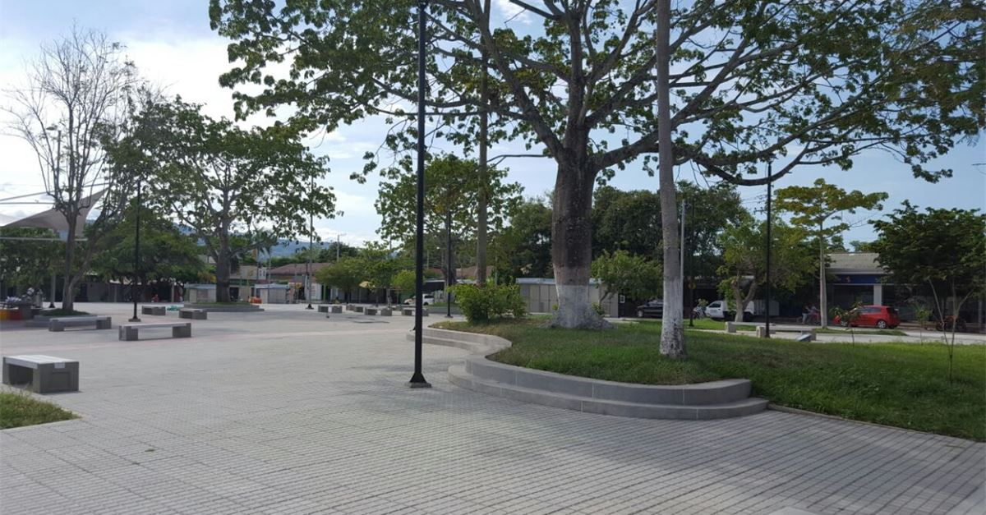
Presentación
Por Diego Bravo A. y Daisy Johana Saldarriaga
Analisis y Desarrollo de software
Instructora Adriana Yaneth Charry
Evidencia GA2-240202501-AA2-EV02

Slide 2
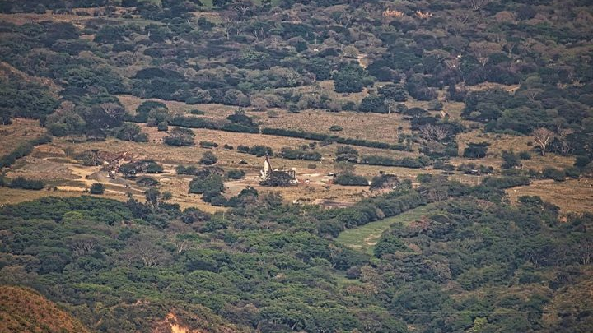
Armero Ruins
memories of a tragedy
Armero ruins are in northern Tolima department, in Armero-Guayabal municipality. The main economical activity in town was agriculture and its population was approximately 45,000 inhabitants. It has 4 rivers crossing through it: Sabandija, Cuamo, Magdalena and Lagunilla. In November 1985 after an eruption of the Nevado del Ruiz volcano, a combination of rocky debris and water destructed the whole city, relocating all the people in Guayabal town

Slide 3
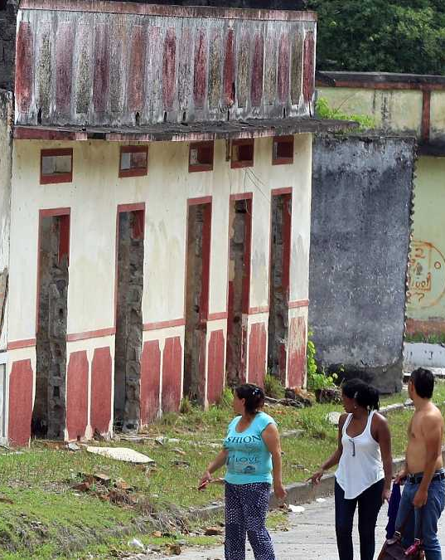
Inside the ruins of a ghost town
As related to today’s Armero ruins, they are spread over a huge area. Some of the building are just part of walls and some others still conserves the original color they had before the tragedy. The most conserved building is the San Lorenzo hospital, and one of the most unaffected area was the graveyard.

Slide 4
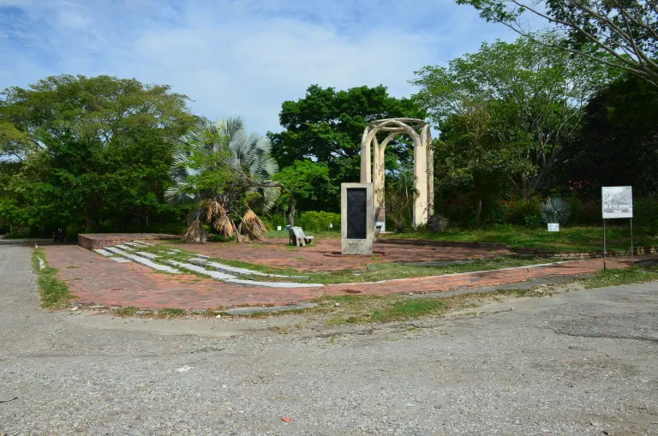
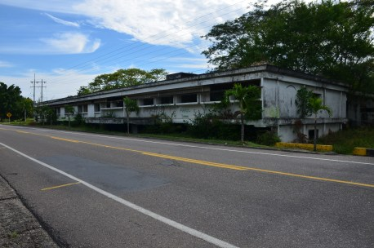
Some points of interest
Los Fundadores Park and Monument: Located in the center of the ruins, There’s a monument in memorial of the town and the victims.
San Lorenzo hospital: the biggest and best conservated structure in the ruins. The part we see through the highway is the second floor, and inside the building you can see the damaged walls and building.

Slide 5
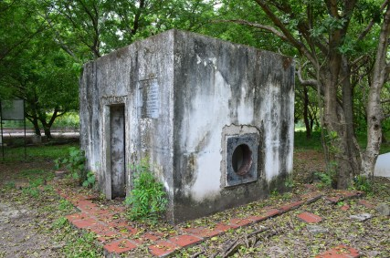
Interesting landmark: Bank’s Vault
A branch of Banco de Colombia, now Bancolombia, was also on Founders Park. Nothing is left but the vault, which survived the disaster completely intact. Thieves came the day after to try and break into it but they failed. Eventually, equipment was flown in from the United States and all the money was recovered by the bank.

Slide 6
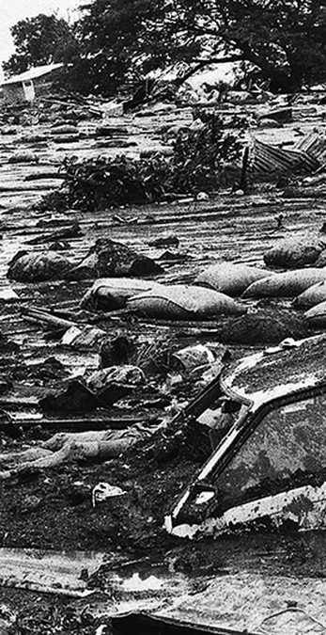
What do you feel about that place?
Diego says:
This is a very depressing place, full of ruins makes me very sad for the people who lived here, it’s terrific being there at nights but also is mysterious and makes me want to explore most of it.
Why did you choose that place?
Because its story is the memory of each one of us and in all of us and all places and corners of Colombia. And will remain always in the people lived that catastrophe and what connects that such a painful event for all parents.
Daisy Says:
asdasdasdasd

